Slide 1
I-ELCAP Screening Process and ELCAP System (Early Lung Cancer Action Program)

Slide 2
Screening Process
Involves many areas of Radiology and other Departments
Patient waiting area
Radiology scanning area
Other medical departments – pulmonology, interventional radiology, PET scanning
If diagnosed, surgery, radiotherapy, other
Involves different types of medically-related expertise
Coordinator/navigator
Radiologist
Other medical specialties

Slide 3
1. Call to Participant
List of potential participants
Dashboard, e.g., like the one created in Phoenix from VistA information about age, smoking history
Coordinator/navigator calls
Discusses screening with potential participant
Documents call in the ELCAP system – Intake Form
Documents smoking history in ELCAP system – Background Form

Slide 4
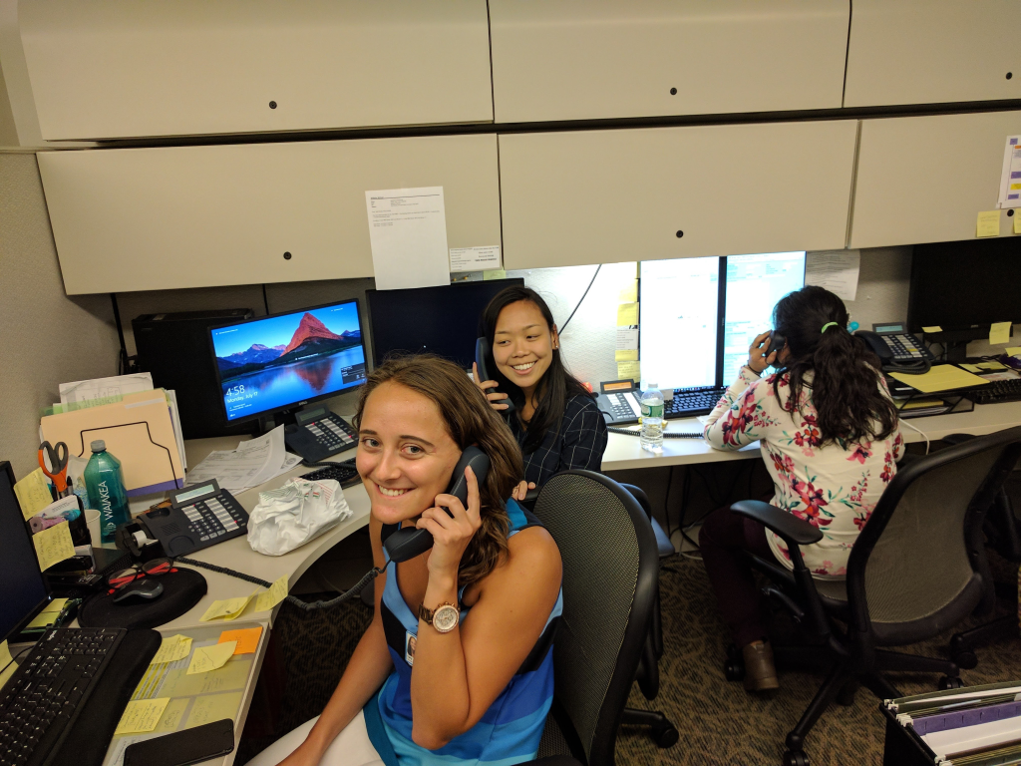
Coordinator Contact and Intake

Slide 5
2. Initial Enrollment
Bring up ELCAP system
New participant
only non HIPAA information in ELCAP system
Assign temporary study id (TMxxxxx) until they actually come for the CT scan
Enter information in Intake Form
Enter smoking history and other information in Background Form

Slide 6
Demo: Log in Create new form Enter Intake and Background Info

Slide 7
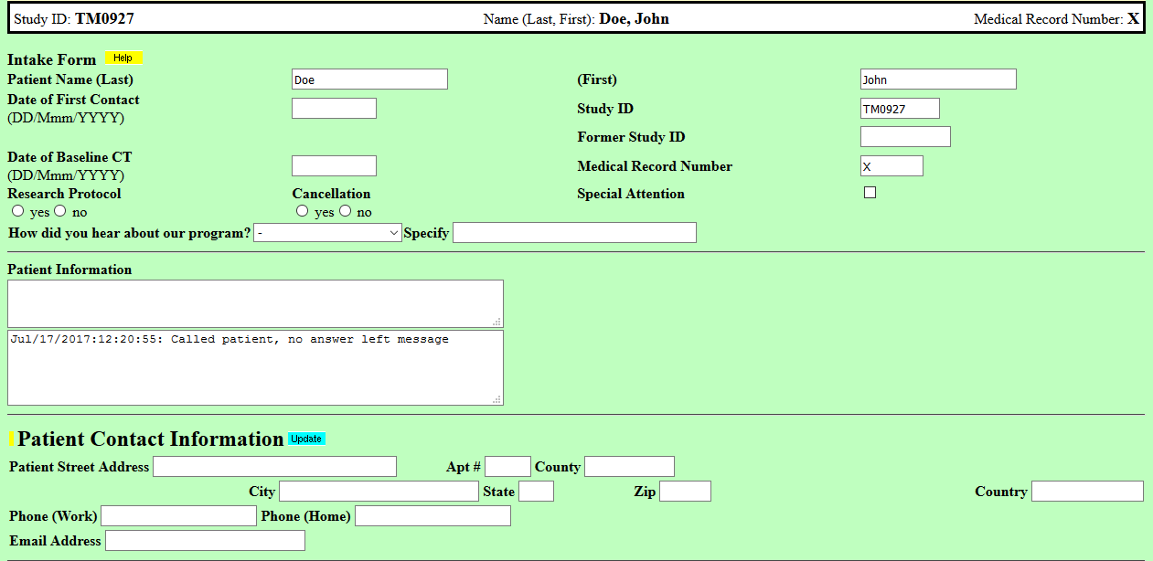
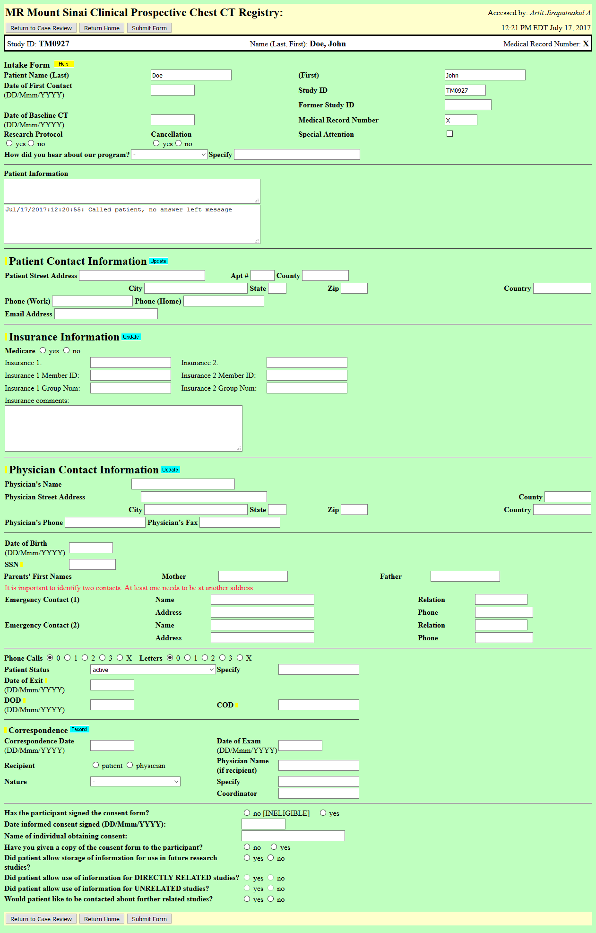
Intake Form

Slide 8
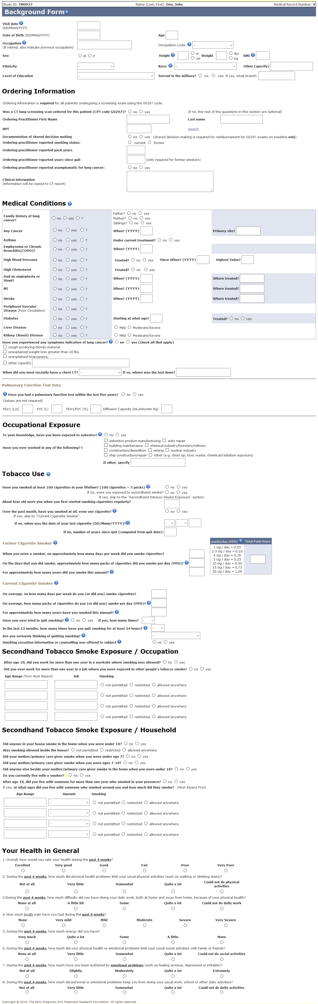
Background Form

Slide 9
3. Schedule low-dose CT Scan
Radiology Department
Have designated time slots or schedule CT as per scheduling system
Meet the participant for CT scan
Obtain any additional needed information
CT scan performed

Slide 10
Demo: Scheduling process

Slide 11
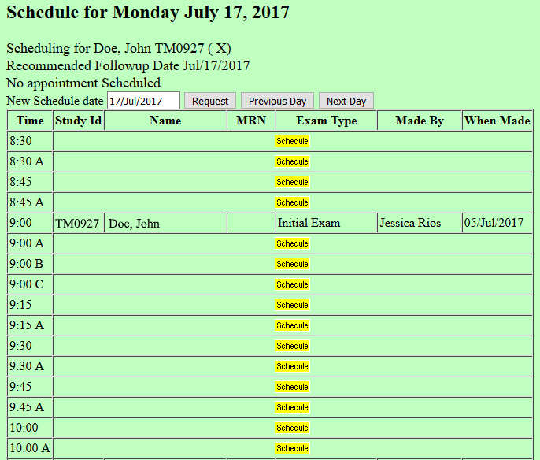
Schedule Form

Slide 12
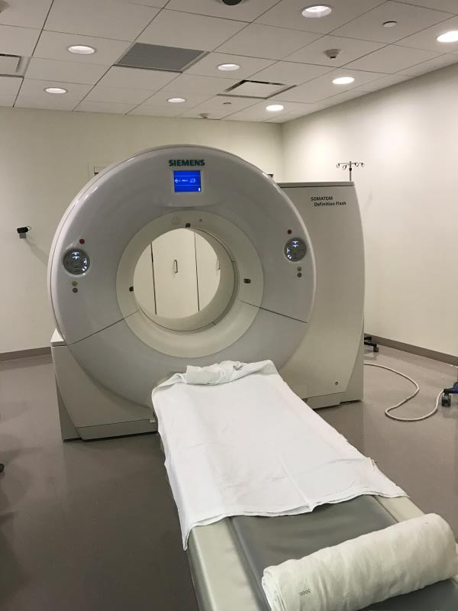
4. Participant Encounter and CT Scanner Room
Coordinator meets the
Participant at the CT
Scanner, completes all
Forms
Scan is performed
Need to insure it is
at low-dose

Slide 13
5. Radiology Reading of Scan
Radiologist reads the CT scan using ELCAP system using Radiology PACS system
Images are in the PACS system
Bring up ELCAP system and use structured ELCAP report which documents findings and provides the follow-up options
Copy structured ELCAP report into Radiology System
ELCAP System
Structured report is the CT Evaluation Form in the ELCAP system
The follow-up dates are available for follow-up listings so that the coordinator can call the participant for the follow-up visit (maybe be 1 month, 3 months, or annual repeat screening
Reports for follow-up calls

Slide 14
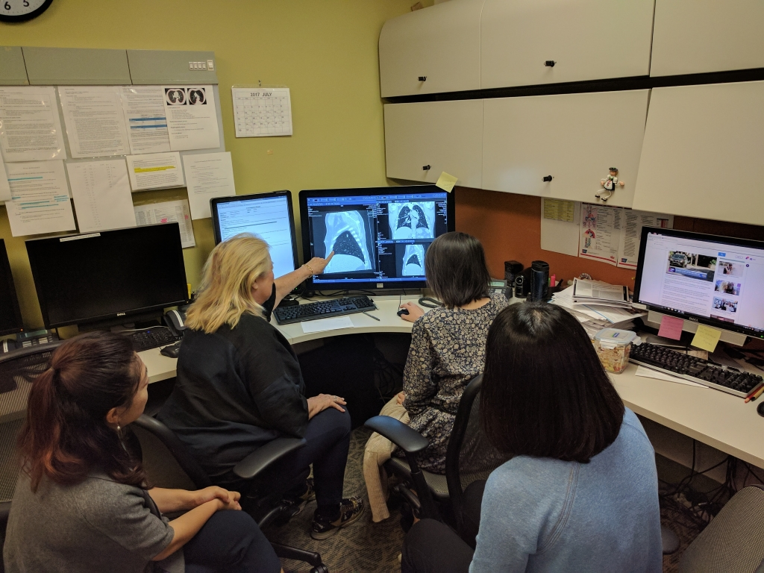
Radiology Reading Area PACS Workstation

Slide 15
Demo: CT Evaluation Form

Slide 16
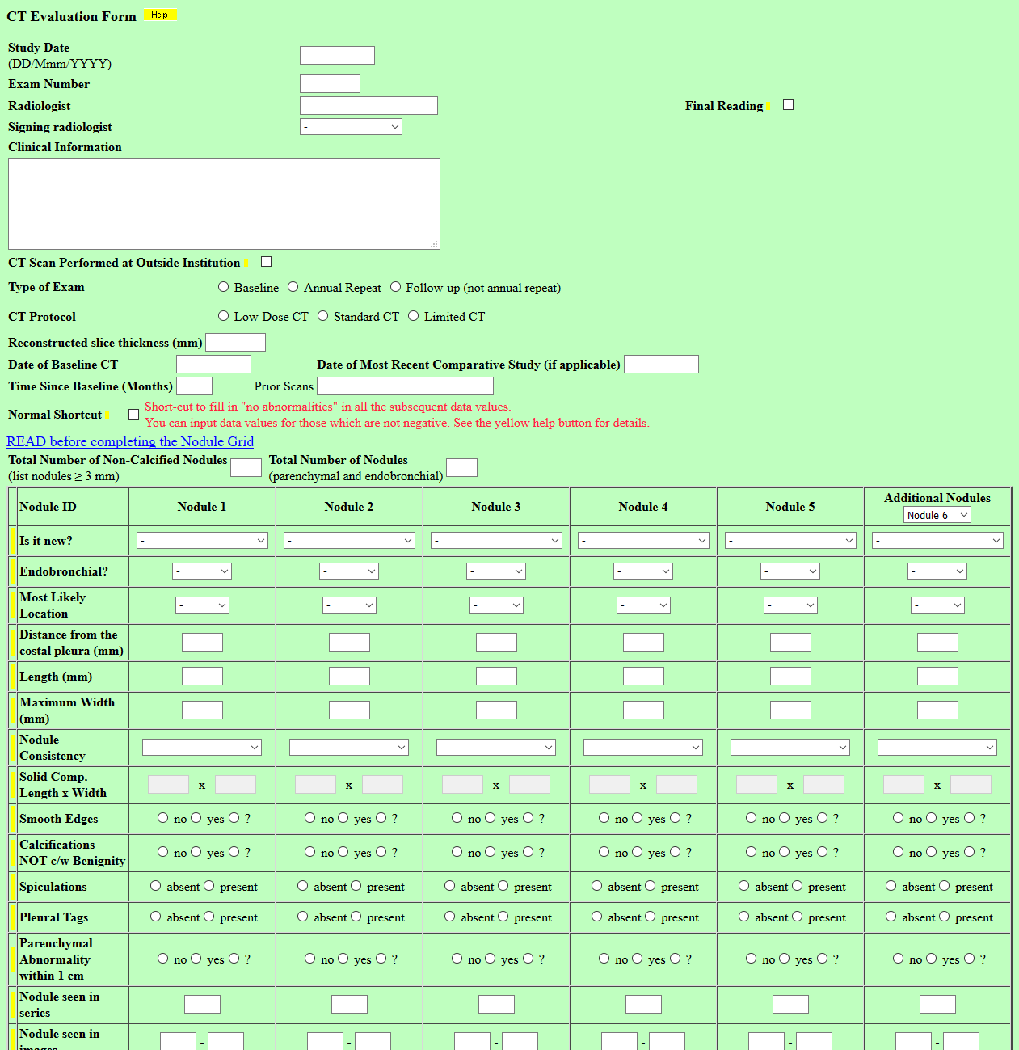
CT Evaluation Form

Slide 17
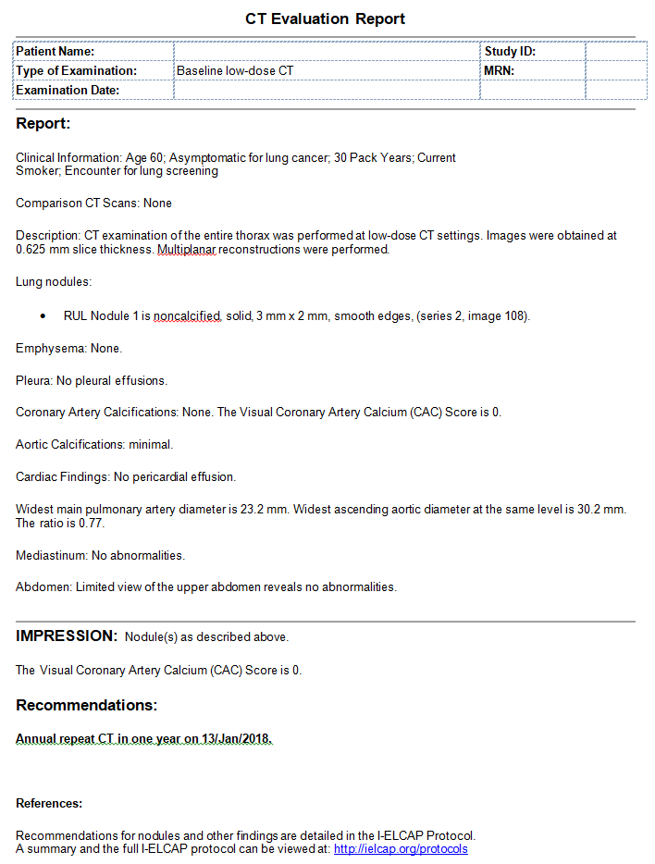
CT Structured Report

Slide 18
Different Reading and Workup Recommendations
I-ELCAP Protocol
Lung-RADS
NCCN guidelines
Fleischner Society guidelines

Slide 19
Baseline Round of Screening
RESULT FINDINGS RECOMMENDATIONS
NEGATIVE: No noncalcified nodules (NCNs) First annual screening 12 months later
SEMI-POSITIVE:
a) Only nonsolid nodules of any size First annual screening 12 months later
b) Largest solid NCN < 6.0 mm or largest solid component of part-solid NCNs <6.0 mm
First annual screening 12 months later
c) Largest solid NCN or solid component of part-solid NCN 6.0 to 14.9 mm with growth at non-malignant rate on CT scan 3 months later First annual screening 12 months later
POSITIVE:
a) Largest NCNs ≥ 15.0 mm Immediate biopsy, PET scan (if NCN ≥ 10 mm), or if likely an infection, follow-up CT in 1 month after antibiotics
b) Largest solid NCN or solid component of part-solid NCN 6.0 to 14.9 mm with growth at malignant rate on CT scan 3 months later or Biopsy or PET scan (if NCN ≥ 10 mm)
c) Solid endobronchial nodule If immediately identified, vigorous coughing and repeat CT immediately at that level
If recognized later, return for repeat CT in 1 month, If still present, see pulmonologist
If no diagnosis of malignancy after workup First annual screening
Any participant diagnosed with lung cancer and treated for curative intent Continue annual CT screening

Slide 20
Annual Rounds of Screening
RESULT FINDINGS RECOMMENDATIONS
NEGATIVE: No NEW or GROWING nodules Next annual screening
SEMI-POSITIVE:
a) Only NEW or GROWING nonsolid NCNs Next annual screening
b) Largest solid NEW or GROWING NCN or solid component of NEW or GROWING part-solid NCN <3.0 mm
Next annual screening
POSITIVE:
a) Largest NEW OR GROWING solid NCN or solid component of NEW or GROWING part-solid NCN 3.0 – 5.9 mm
Follow-up CT in 6 months, if growth at a malignant rate, Bx
b)Largest NEW or GROWING solid NCN or solid component of NEW or GROWING part-solid NCN ≥ 6.0 mm
Follow-up CT in 1 month, possibly after antibiotics, if growth
at a malignant rate, biopsy
c) Solid NEW endobronchial nodule If immediately identified, vigorous coughing and repeat CT
immediately at that level
If recognized later, return for repeat CT in 1 month, If still present, see pulmonologist
*if growth at a malignant rate Biopsy or PET
If no diagnosis of malignancy after workup Next annual screening

Slide 21

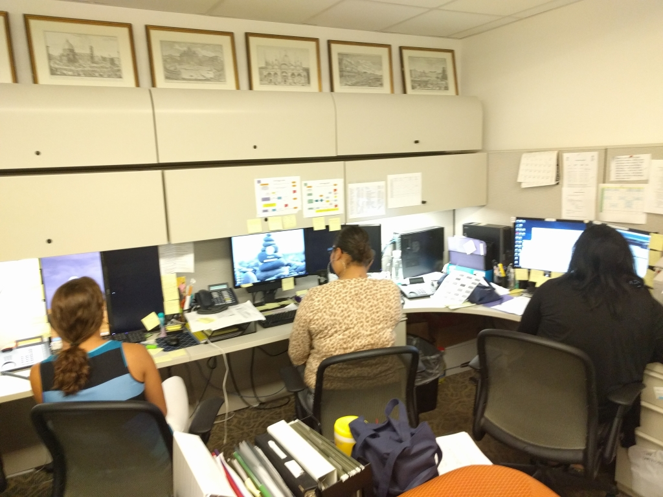
6. Back to the Coordinator

Slide 22
Coordinator/navigator Follow-up After CT Scan
Follow-up call is very important for adherence
Send report with lay cover explanation
Look up follow-up lists
Call and schedule follow-up visit
For annual repeat screening
Send letters 3 months in advance
Follow-up with calls – 2 and 1 month in advance
Important as it takes the burden off of the primary care physician
Important to be consistent to get buy-in from the primary care physician

Slide 23
7. Multi-disciplinary Group
Multi-disciplinary Group
Recommendations other than low-dose CT follow-up are referred to this group
Decides what is recommended
Recommendations need to be documented
May include a Nurse Navigator who contacts the participant
PHOTO

Slide 24
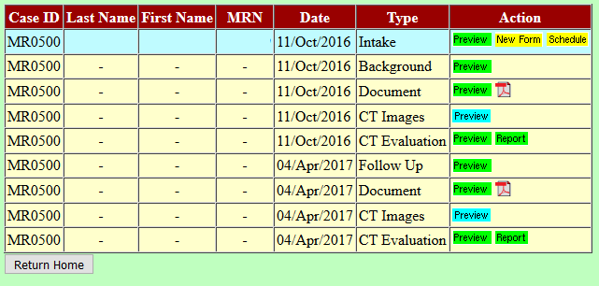
Case Review Form Summary of all forms and images for each participant
We also have cytology and pathology images

Slide 25
Demo: Biopsy Form PET Scan Form

Slide 26
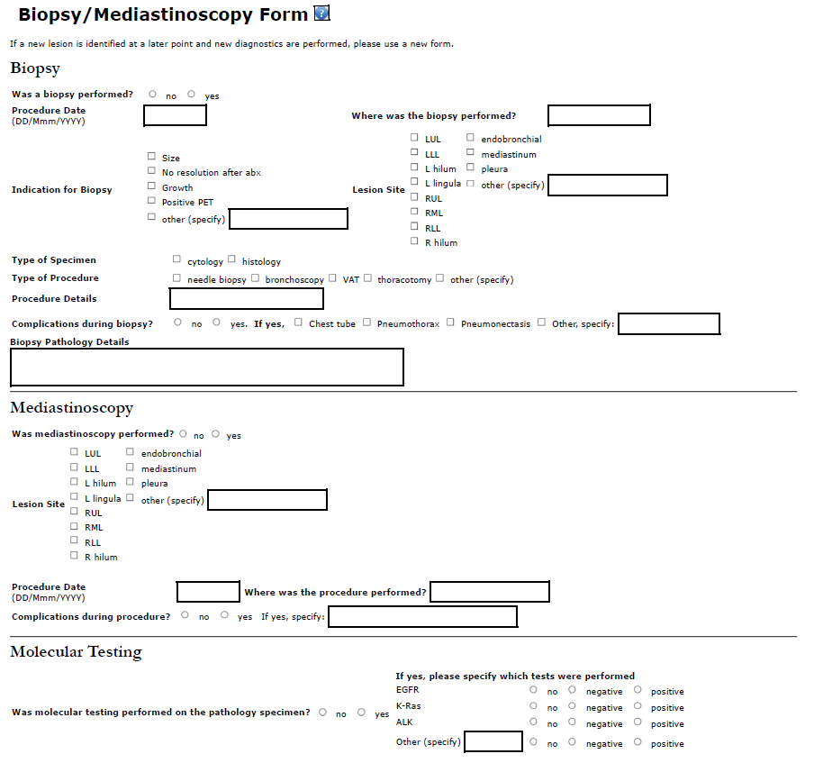
Biopsy Form

Slide 27
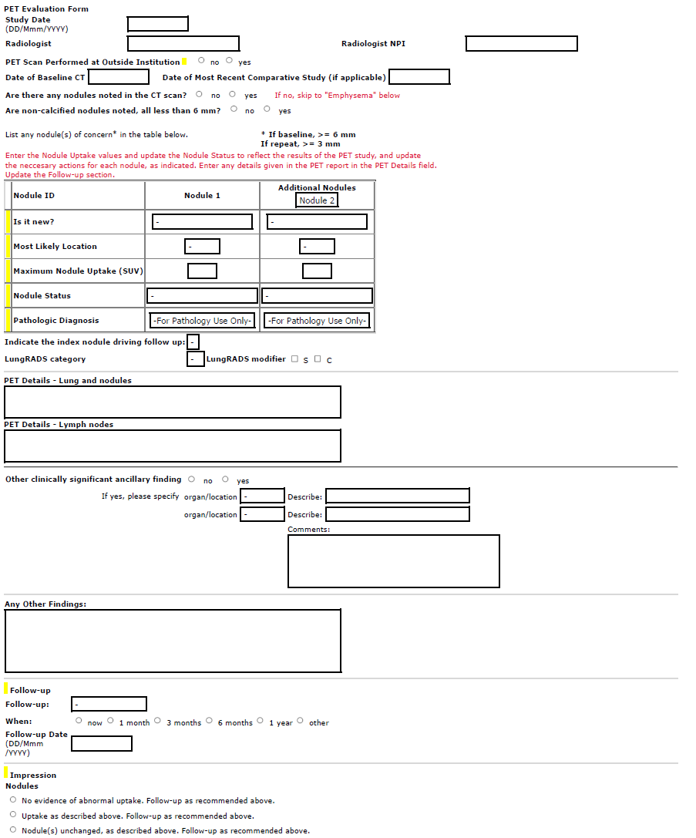
PET Scan Form

Slide 28
8. Follow-up Form
Used for each follow-up visit, regardless of when they return

Slide 29
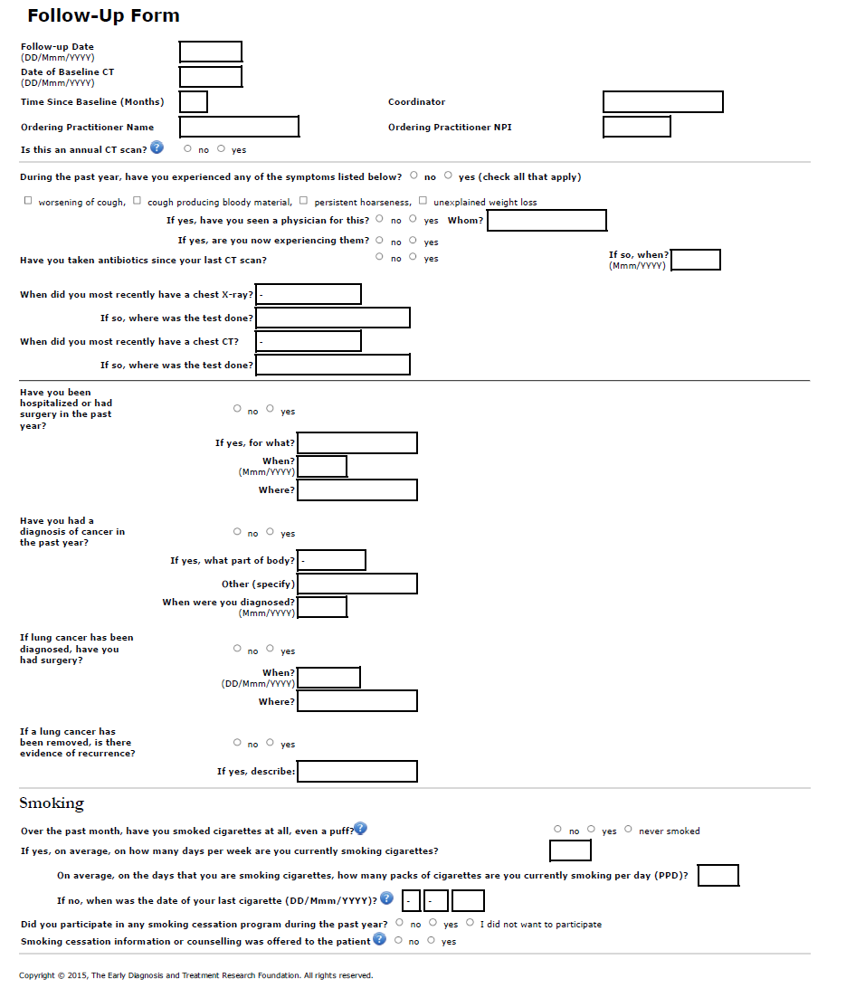
Follow-up Form

Slide 30
9. Diagnosis of Lung Cancer
Must be documented in ELCAP System
Is also documented in VistA system

Slide 31
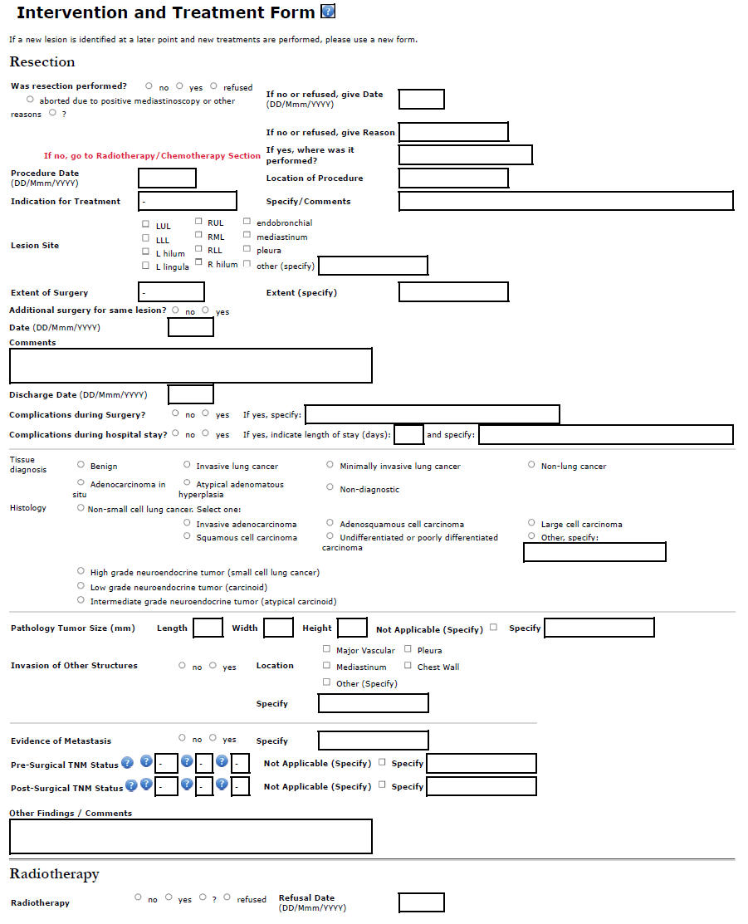
Intervention Form

Slide 32
Flow Chart of System Interactions of ELCAP with VistA
Extract info from VistA for initial contact
Use ELCAP system for data and images
Send CT report to VistA
Multi-disciplinary groups can use VistA or ELCAP system to call up cases for review and recommendations
Follow-up visits need to be documented in the ELCAP system
Send any follow-ups visit to VistA

Slide 33
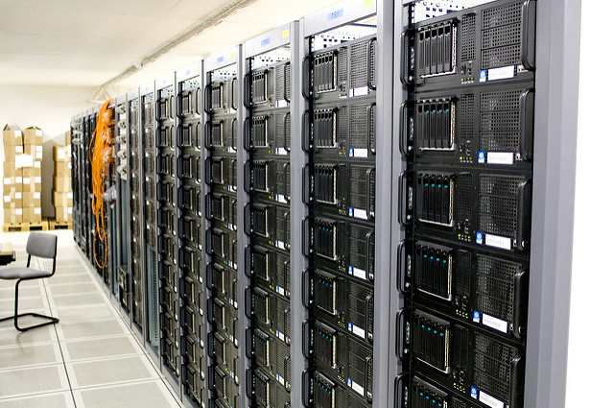


Flow Chart of System Interactions of ELCAP with VistA
VistA
Final CT Report
Extract info from VistaA for initial contact
Follow-up data
Structured CT Report
Final CT Report
PACS
Images
ELCAP System – Used for data and images

Slide 34
10. Reports on Screening Process
Reports of the screening process based on the ELCAP system
Needed on an ongoing basis to check on
Frequency of positive results
Frequency of invasive procedures
Frequency of lung cancer

Slide 35
Demo: Key Reports

Slide 36
Report: Case Review Form Summary of all forms and images for each participant
We also have cytology and pathology images

Slide 37
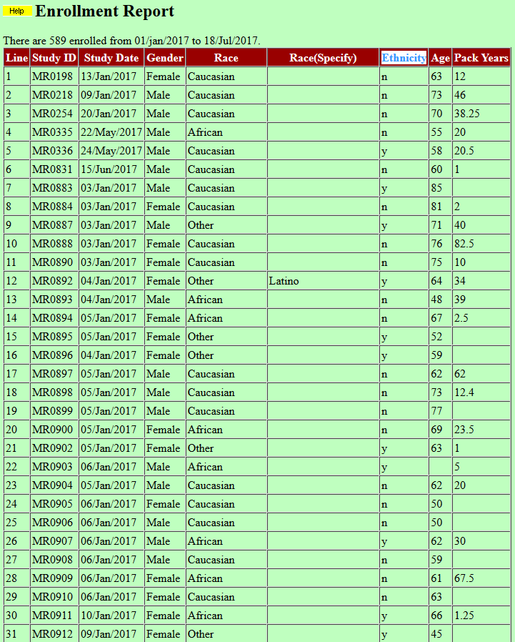
Enrollment Report

Slide 38
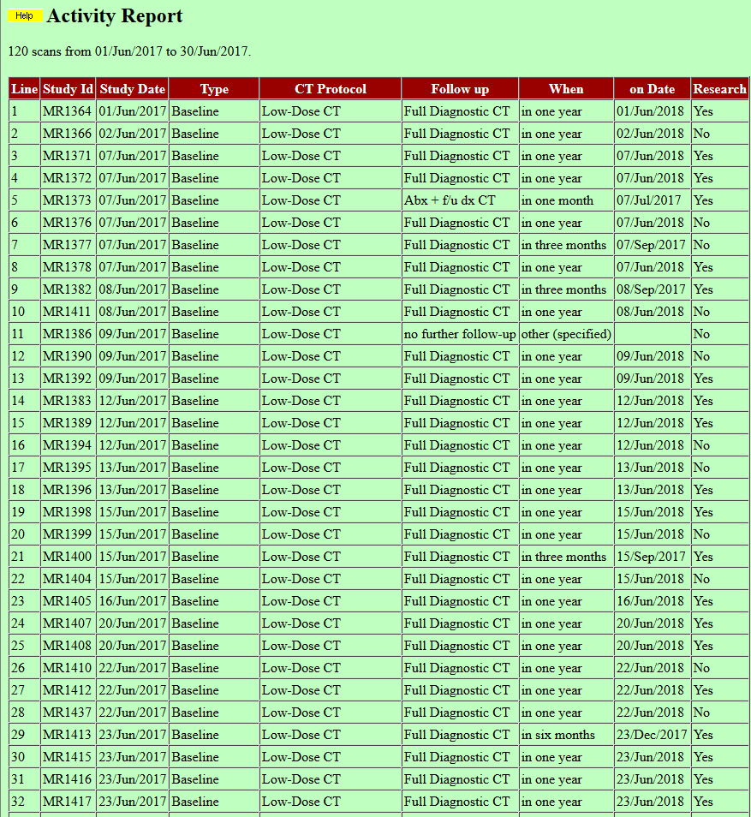
Activity Report

Slide 39
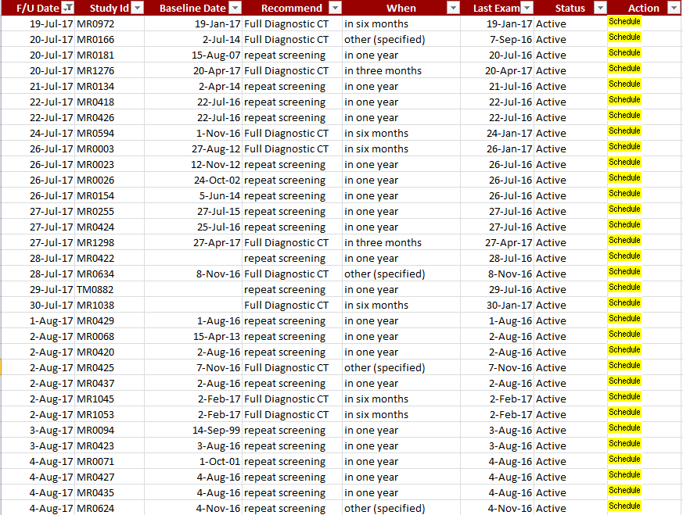
Follow-up List:

